Slide 1
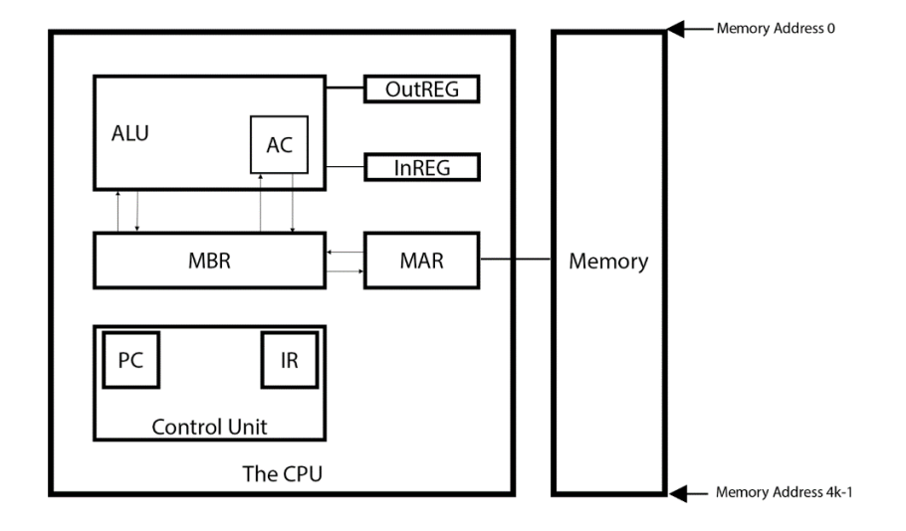
Problem 1
MARIE system architecture
Output
intermediate
data store
Input
0x????
1st Hex Number :Instruction
2nd-4th Hex Number :Data
Date Transfer
Instruction
Next Instruction

Slide 2
Problem 2:
write a simple program that: • accepts user input for variables A, B, C, D, • calculates the expression (C + 3 * A – (2 * B + D)) • stores the result in variable E • prints the result on screen (via ‘Output’).
Define ABCD to accept user input
Define E to store the final result
Accept user input and store it to A~D in sequence
calculates the expression (C + 3 * A – (2 * B + D))That is C+A+A+A-B-B-D
Store the result in E
Output the results in E

Slide 3
Problem 3:
• Write a program that calculates the binomial-coefficient “n over k” of the two entered integer values n and k
Define Cur to Store user input
Define MAX to store the biggest number
Store and Check User Input
<0: Re-enter
==0: Output
>0: if(Cur>MAX) Update MAX to Cur
Output the MAX

Slide 4
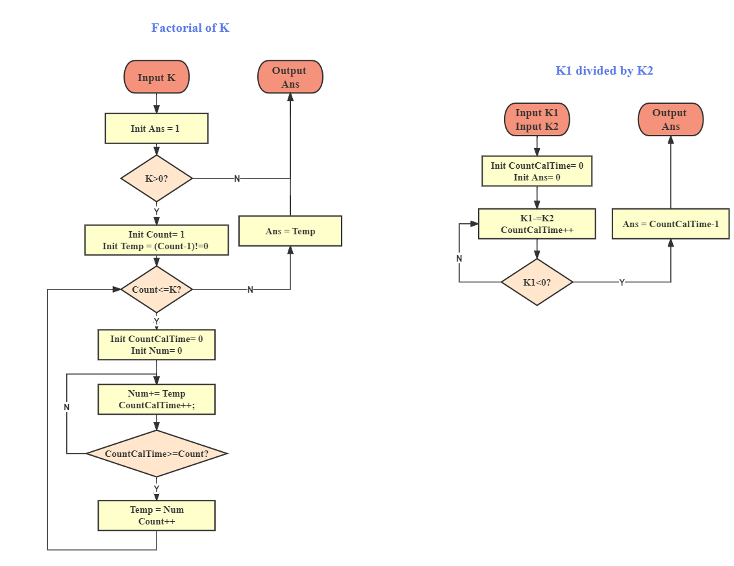

Problem 4:
• Write a program that calculates the binomial-coefficient “n over k” of the two entered integer values n and k
→Cn,k=n!/(n-k)!/k!
→n>=k>=0(Legal Input)
(Count)!=count*(count-1)!
==count*temp
//Auxiliary variables need to be initialized after each calculation
Temp,DEC 1
Count,DEC 1
Num,DEC 0
CountCalTime, DEC 0
Constant1,DEC 1

